Slide 1
Locking in Forms
Notes:
Schedule: Timing Topic
17 minutes Lecture
17 minutes Total

Slide 2
Objectives
After completing this lesson, you should be able to do the following:
  Identify the locking mechanisms in Forms
  Write triggers to invoke or intercept the locking process
  Plan trigger code to minimize overheads
  on locking
Notes:
Overview
Locking is an important consideration in multiuser applications that access the database. This lesson shows you how Forms handles locking and how you can design forms with these mechanisms in mind.

Slide 3

Locking
Insert, update, or delete
Row in (X)
Insert, update, or delete
Row in (X)
Query
Table in (RX)
Notes:
Locking
In database applications, locking maintains the consistency and integrity of the data, where several users are potentially accessing the same tables and rows. Forms applications are involved in this locking process when they access database information.
Oracle9i Locking
Forms applications that connect to an Oracle9i database are subject to the standard locking mechanisms employed by the server. Here is a reminder of the main points:
Oracle9i uses row-level locking to protect data that is being inserted, updated, or deleted.
Queries do not prevent other database sessions from performing data manipulation. This also applies to the reverse situation.
Locks are released at the end of a database transaction (following a rollback or commit).

Slide 4
Notes:
Locking (continued)
A session issues locks to prevent other sessions from performing certain actions on a row or table. The main Oracle9i locks that affect Forms applications are the following:

Slide 5
Default Locking in Forms
Insert record
No locks
Update record
RS on table
Delete record
RS on table
Action
Save
RX on above
Notes:
Default Locking in Forms
Forms initiates locking automatically when the operator inserts, updates, or deletes records in a base table block. These locks are released when a save is complete.
Forms causes the following locks on Oracle base tables and rows, when the operator performs actions:
*Update of nondatabase items with the Lock Record property set to Yes also causes this.
The exclusive locks are applied to reserve rows that correspond to records that the operator is deleting or updating, so that other users cannot perform conflicting actions on these rows until the locking form has completed (Saved) its transaction.

Slide 6
Concurrent Updates and Deletes
  When users compete for the same record, normal locking protection applies.
  Forms tells the operator if another user has already locked the record.
Notes:
Concurrent Updates and Deletes
What Happens When Users Compete for the Same Row?
Users who are only querying data are not affected here. If two users are attempting to update or delete the same record, then integrity is protected by the locking that occurs automatically at row level.
Forms also keeps each user informed of these events through messages and alerts when:
A row is already locked by another user. The user has the option of waiting or trying again later.
Another user has committed changes since a record was queried. The user must requery before the user’s own change can be applied.

Slide 7
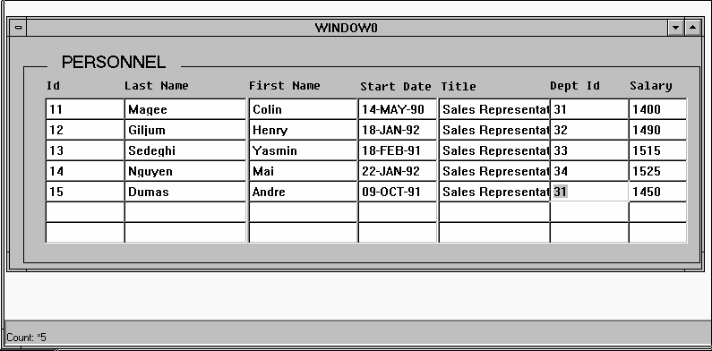
User A: Step 1
Notes:
Example: Two Users Accessing the Same Record
1. User A is running the Personnel application and queries the sales
representatives. The record for employee 15, Dumas, is updated so that his department is changed to 31.
User A does not save the change at this point in time. The row that corresponds to the changed record is now locked (exclusively).

Slide 8
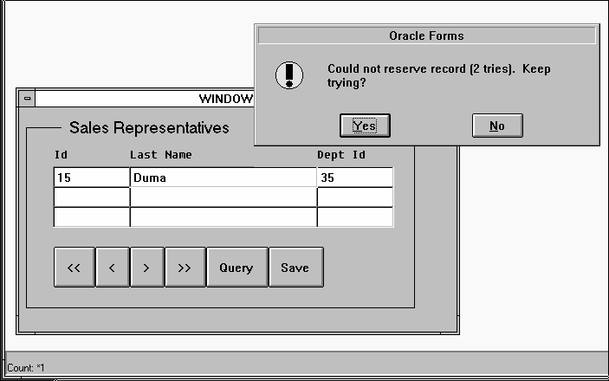
User B: Step 2
Notes:
Example: Two Users Accessing the Same Record (continued)
2. User B is running the same application and has started a form that accesses the sales representatives. Employee Dumas still appears in department 15 in this form, because User A has not yet saved the change to the database.
User B attempts to update the record by changing the sales representative’s name to Agasi. Since this action requests a lock on the row, and this row is already locked by User A, Forms issues an alert saying the attempt to reserve the record failed. This user can request additional attempts or reply No and try later.
User B replies No. This results in the fatal error message 40501, which confirms that the original update action has failed.
Instructor Note
Show a similar example, by starting two separate Forms run-time sessions.
Apply the actions as given in steps 1-4.

Slide 9
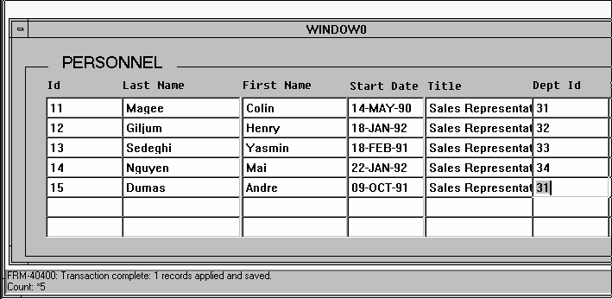
User A: Step 3
Notes:
Example: Two Users Accessing the Same Record (continued)
3. Back in the Personnel form, User A now saves the change to Dumas’ department, which applies the change to the database row and then releases the lock at the end of the transaction.

Slide 10
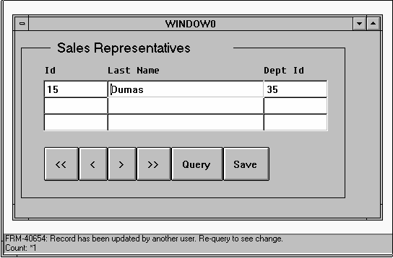
User B: Step 4
Notes:
Example: Two Users Accessing the Same Record (continued)
4. In the Sales Representatives form, User B can now alter the record. However, because the database row itself has now changed since it was queried in this form, Forms tells User B that it must be requeried before a change can be made.
This situation is shown in the lower slide, opposite. Once User B requeries, the record can then be changed.

Slide 11
Locking in Triggers
Achieved by:
  SQL data manipulation language
  SQL explicit locking statements
  Built-in subprograms
  DML statements
Notes:
Locking in Triggers
In addition to the default locking described earlier, database locks can occur in Forms applications because of actions that you include in triggers. These can be:
SQL data manipulation language (DML): Sometimes you may need to perform INSERT, UPDATE, and DELETE statements, which add to those that Forms does during the saving process (posting and committing). These trigger SQL commands cause implicit locks on the tables and rows that they affect.
SQL locking statements: You can explicitly issue locks from a trigger through the SELECT . . . FOR UPDATE statement. The LOCK TABLE statement is also allowed, though rarely necessary.
Built-in subprograms: Certain built-ins allow you to explicitly lock rows that correspond to the current record (LOCK_RECORD) or to records fetched on a query (ENTER_QUERY and EXECUTE_QUERY).
To keep locking duration to a minimum, DML statements should be used only in transactional triggers. These triggers fire during the process of applying and saving the user’s changes, just before the end of a transaction when locks are released.

Slide 12
Notes:
Locking in Triggers (continued)
Locking by DML Statements
If you include DML statements in transactional triggers, their execution causes:
Row exclusive lock on the affected table
Exclusive lock on the affected rows
Because locks are not released until the end of the transaction, when all changes have been applied, it is advantageous to code DML statements as efficiently as possible, so that their actions are completed quickly.

Slide 13
Locking with Built-ins
  ENTER_QUERY (FOR_UPDATE)
  EXECUTE_QUERY (FOR_UPDATE)
Notes:
Locking with Built-ins
Forms maintains a hidden item called rowid in each base table block. This item stores the ROWID value for the corresponding row of each record. Updates or deletes in triggers that apply to such rows can identify them most efficiently using this value, as in the example below:
UPDATE orders
SET order_date = SYSDATE
WHERE ROWID = :orders.rowid;
Locking with Built-in Subprograms
The following built-ins allow locking:
EXECUTE_QUERY (FOR_UPDATE) and ENTER_QUERY (FOR_UPDATE): When called with the FOR_UPDATE option, these built-ins exclusively lock the rows fetched for their query. Care should be taken when reserving rows in this way, because large queries cause locking on many rows.
LOCK_RECORD: This built-in locks the row that corresponds to the current record in the form. This is typically used in an On-Lock trigger, where it has the same effect as Forms’s default locking.

Slide 14
On-Lock Trigger
Example
IF USER = 'MANAGER' THEN
LOCK_RECORD;
ELSE
MESSAGE('You are not authorized to change
records here');
RAISE form_trigger_failure;
END IF;
Notes:
On-Lock Trigger
This block-level trigger replaces the default locking that Forms normally carries out, typically when the user updates or deletes a record in a base table block. The trigger fires before the change to the record is displayed. On failure, the input focus is set on the current item.
Use this trigger to:
Bypass locking on a single-user system, hence speeding processing
Conditionally lock the record or fail the trigger (Failing the trigger effectively fails the user’s action.)
Handle locking when directly accessing non-Oracle data sources
If this trigger succeeds, but its action does not lock the record, then the row remains unlocked after the user’s update or delete operation. Use the LOCK_RECORD built-in within the trigger if locking is not to be bypassed.

Slide 15
Notes:
On-Lock Trigger (continued)
Example
The following On-Lock trigger on the block Stock only permits the user MANAGER to lock records for update or delete.
IF USER = 'MANAGER' THEN
LOCK_RECORD;
IF NOT FORM_SUCCESS THEN
RAISE form_trigger_failure;
END IF;
ELSE
MESSAGE('You are not authorized to change records here');
RAISE form_trigger_failure;
END IF;

Slide 16
Summary
  Default locking
    Locks rows during update and delete
    Informs user of concurrent update and delete
  Locking in triggers
    Use SQL and certain built-ins
    On-Lock trigger: LOCK_RECORD built-in available
Notes:
Summary
Default Locking
Locks rows during update and delete
Informs user about concurrent update and delete
Locking in Triggers
Use SQL and certain built-ins
On-Lock trigger: LOCK_RECORD built-in available

